Slide 1
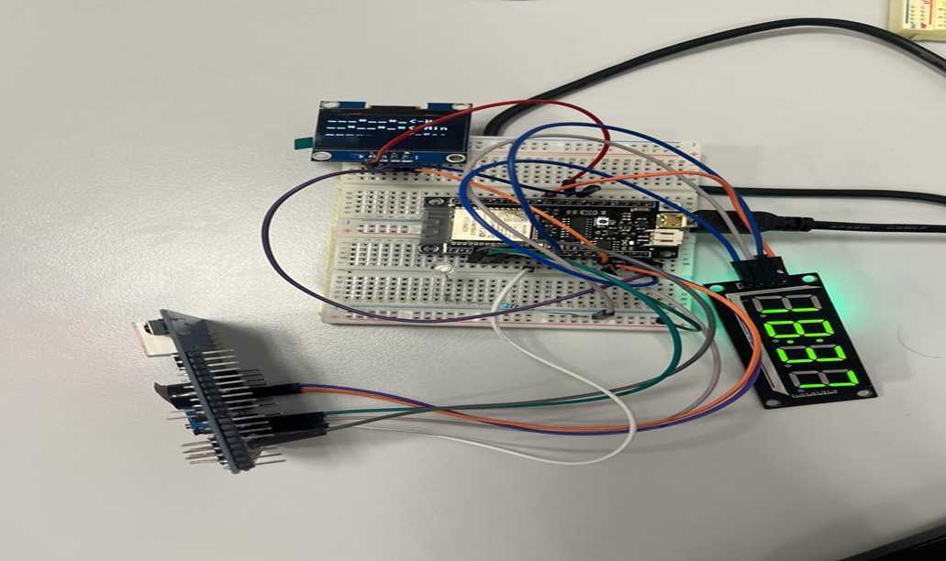
CLOCK AND ALARM

Slide 2
WHAT WE USED
The ESP32 board as the main microcontroller
The Breadboad for the making the connections between devices
The TM1637 for the clock
The SH1106 I2C OLED display 128x64 for the binary hour and for displaying the alarm hour
The Multifunctional Shield for the alarm sound and for changing the alarm hour

Slide 3
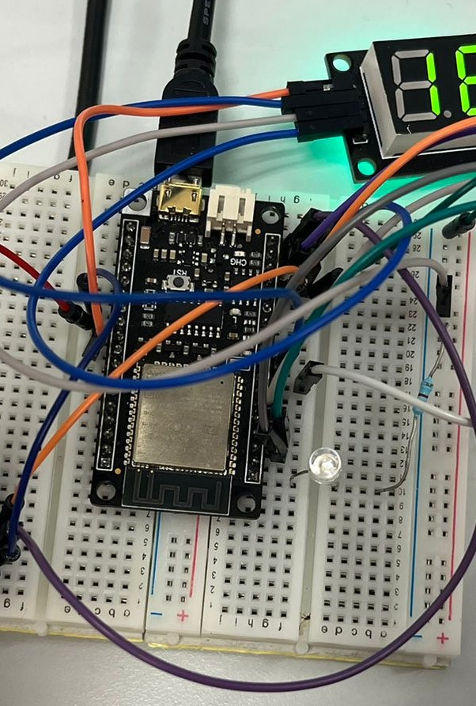
ESP 32
This board is the main board of this program controlling all other
In this program we use the GPIOS 25, 26, 27, 13, 19, 21 and 22
We also use the GND, AREF, 3V3 and VCC
It should be noted that we use an LED that flashes every 10 minutes, so we know that we are confirming the current time on the internet

Slide 4
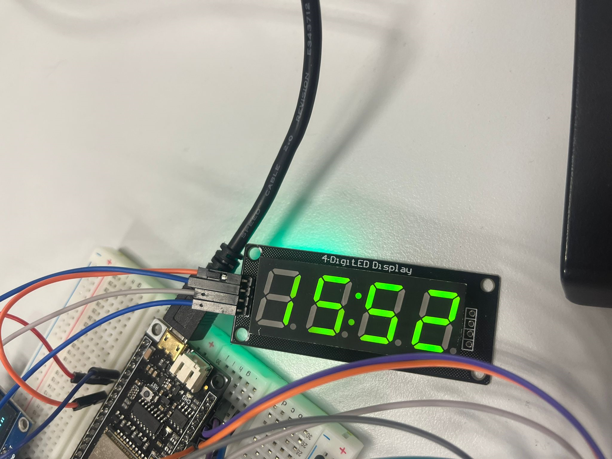
TM1637
We use this device for displaying the hour
We use the colon so that they blink when the code is executing

Slide 5
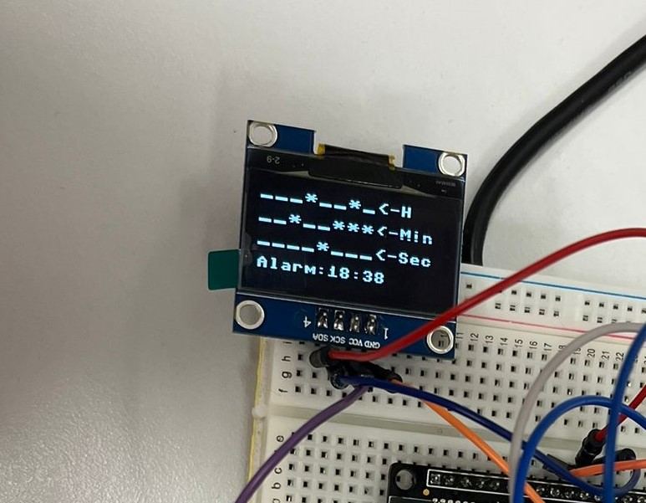
SH1106 I2C OLED display 128x64
This is used to display the binary hour in hours, minutes and seconds
The * refers to the ‘1’ and the _ to the ‘0’
This is also used for displaying the alarm hour, when the column will sound the alarm

Slide 6
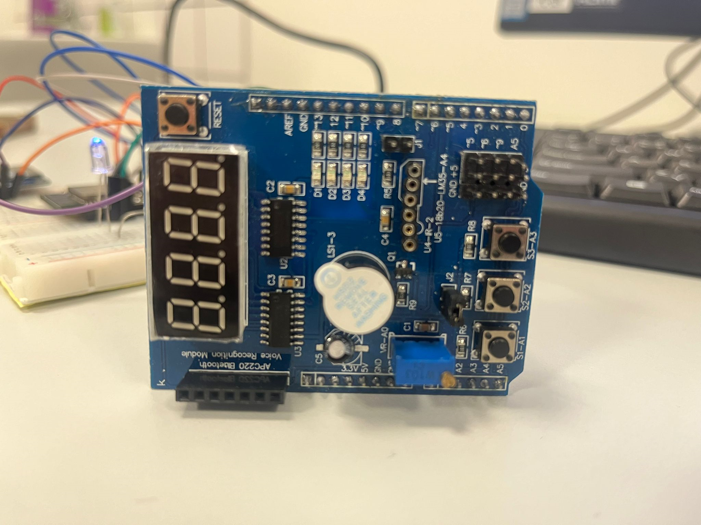
Multifunction shield
We use this to sound the available alarm in the shiel for 10 seconds
We also use this to change the alarm hour, the S3 button add 1 minute to the alarm hour, the S2 button add 1 hour and finally the S1 button reset the alarm

Slide 7
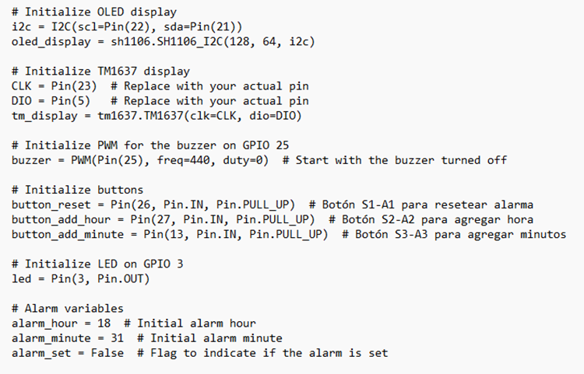
Software: Initialization
In these lines of code, we are initialising the elements we are going to use later

Slide 8
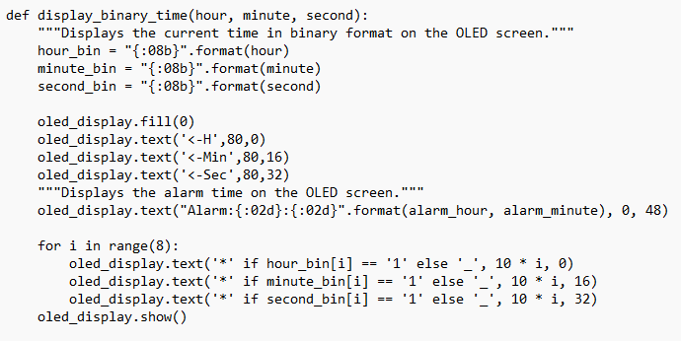
software: Define functions
For example, one of the most important functions we have to define is the display binary time

Slide 9
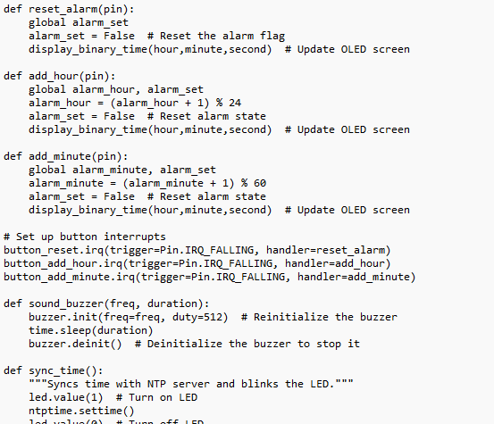
Software: define functions
Other examples are:

Slide 10
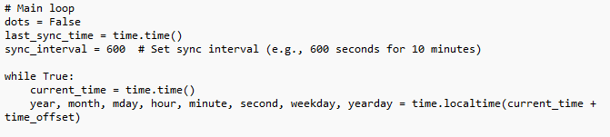
Software: MAIN LOOP
The main loop continuously runs and handles various tasks such as updating and displaying the current time, checking for alarm activation, and blinking dots on the TM1637 display.

Slide 11
CONCLUSION
This script combines hardware initialization, time synchronization, button handling, and display updates to create a clock with alarm functionality.
The clock displays the current time on both an OLED display and a TM1637 display, and it triggers a buzzer when the set alarm time is reached.
Buttons allow users to interact with the clock, setting the alarm time or resetting the alarm.
The script continuously runs these operations in a loop to keep the clock functioning.

